Slide 1


Dept. of CS&E ( DATA SCIENCE)
Adichunchanagiri Institute of Technology
Chikkamagaluru - 577102
Mini Project
“ Diagnosis of Skin Diseases and Treatment Recommendation ”
Presented By,
BHAVANA H P (4AI22CD005)
BHAVANA K R (4AI22CD006)
DEEPIKA B J ( 4AI22CD016)
PALLAVI K M ( 4AI22CD038)
Under the Guidance of
Prof. Gaganadeepa J

Slide 2
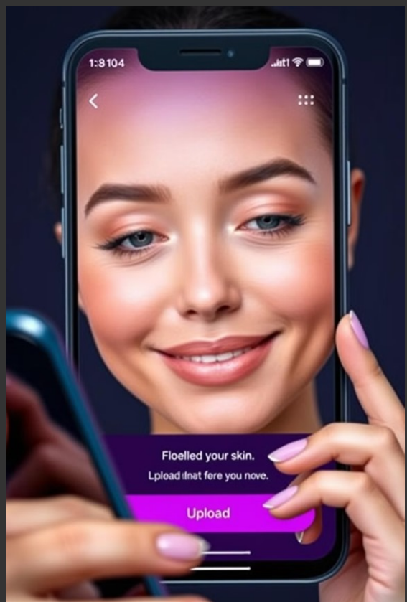
Problem Statement
The aim is to create a basic web-based
application that allows users to input the name of a
skin disease and receive relevant information
about it. The application demonstrates a simple
approach to diagnosing skin diseases and
suggesting potential treatments.

Slide 3
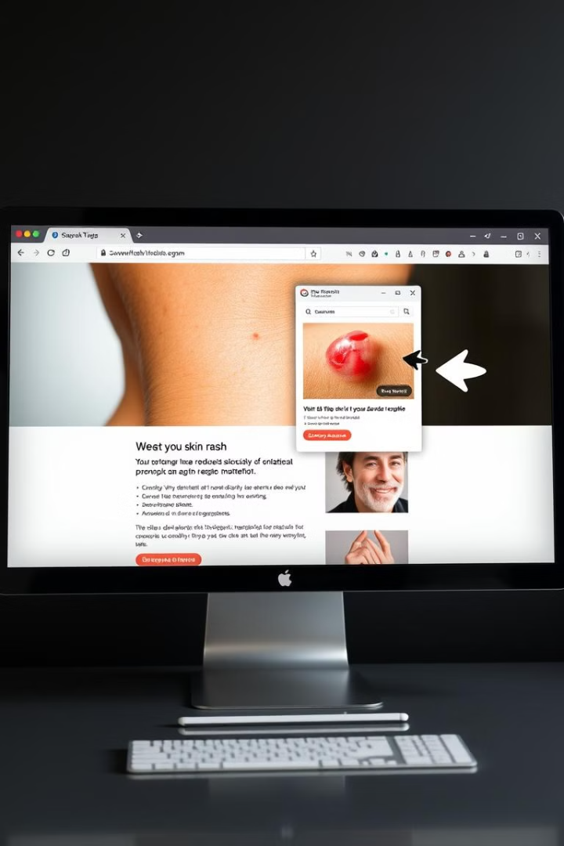
Scope of the Project
1
Image Analysis
2
Disease Classification
The system analyzes images of skin lesions for disease identification.
Categorizes diseases based on visual characteristics and medical knowledge.
3
Treatment Recommendation
4
User Interface
A user-friendly web interface for uploading images and receiving results.
Provides relevant treatment options tailored to the diagnosed disease.

Slide 4




Project Design
1
Data Collection
2
Model Training
3
User Interface
4
Deployment

Slide 5
Methodology
Data Preprocessing
Feature Extraction
Model Training
Cleaning and preparing images for training the model.
Extracting relevant features from images, such as color and texture.
Training a machine learning model to recognize patterns in skin diseases.

Slide 6




pseudocode
Load dataset from 'static/data/skin_disease_dataset.xlsx' into a data structure (e.g., DataFrame)
# Define routes and their corresponding functions
Define route '/' for the home page
Define route '/about' for the about page
Define route '/rec' for the recommendation page
Define route '/brands' for the brands page
Define route '/contact' for the contact page
# Define route '/get_disease_info' for handling disease information requests
Get the disease name from the request parameters
Search the dataset for the entered disease name
If the disease is found:
Extract disease name, image link, treatment, and symptoms
Return the extracted information as JSON response
Else:
Return an error message indicating the disease is not found
# Run the Flask application in debug mode
Implementation
Python
Javascript
Machine learning model development and image processing.
Dynamic interaction and user interface responsiveness.
Javascri
HTML
CSS
Structure of the web interface, layout, and elements.
Styling and visual presentation of the web interface.

Slide 7
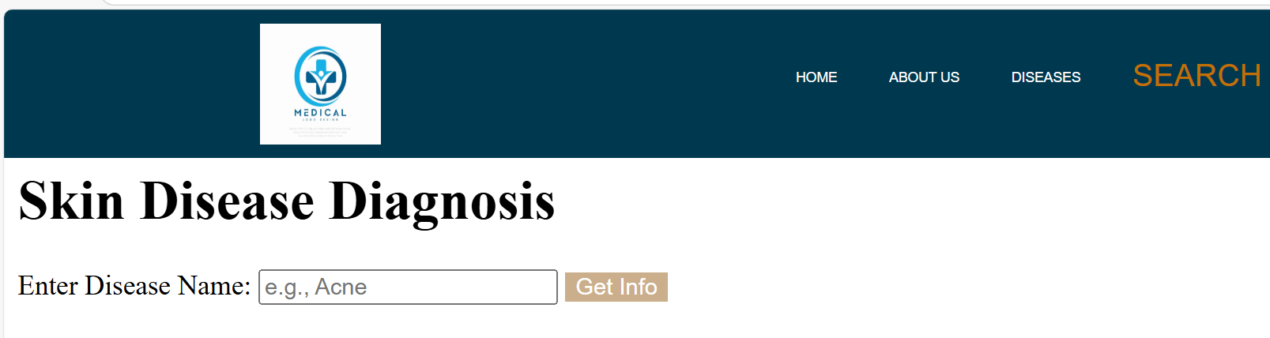
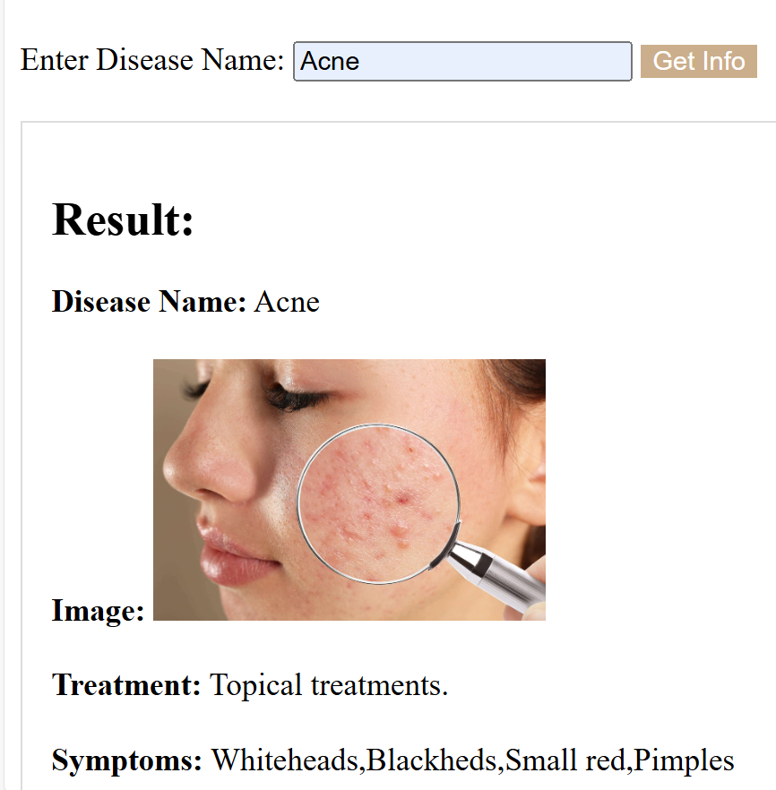
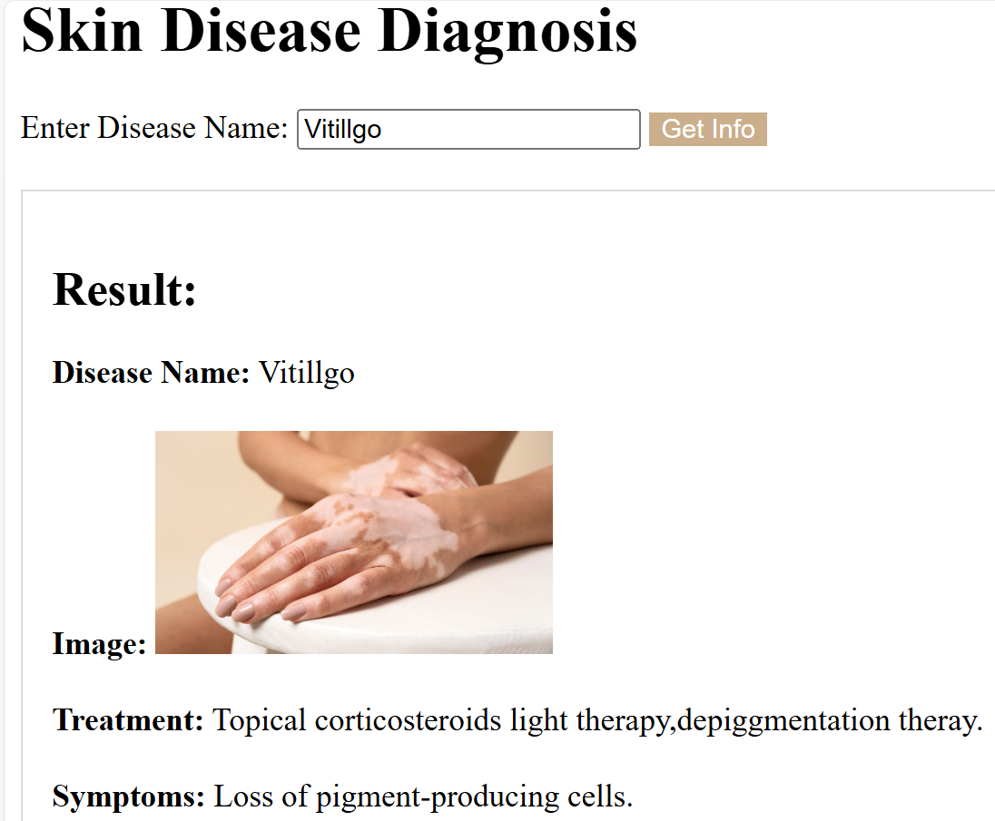
Results

Slide 8
Challenges
Data Enhancement:
Use curated datasets from reputable sources.
Regularly update and validate the dataset.
Consider incorporating structured data for better organization and search.
Improved Diagnosis:
Explore advanced image analysis techniques for more accurate visual diagnosis.
Integrate symptom checkers and decision support systems to improve diagnostic accuracy.
Personalized Recommendations:
Allow users to input relevant medical history and other factors.
Incorporate AI-powered algorithms to generate personalized treatment plans.

Slide 9
Future Work
The proposed future work for this project involves expanding the dataset with a wider range of skin diseases and diverse patient demographics to enhance model generalizability.
Additionally, incorporating multimodal data, such as patient history and symptoms, could further improve diagnostic accuracy.

Slide 10
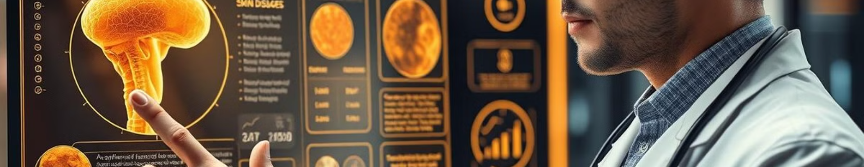
Conclusion
The project successfully developed a web Application for diagnosing skin diseases and recommending treatments. It has potential to improve healthcare access and efficiency.
Future work will focus on expanding the dataset, incorporating new features, and refining the
model for higher accuracy.

